Slide 1
File-System Interface
File Concept
Access :Methods
Directory Structure
Protection
Consistency Semantics

Slide 2
File Concept
The OS abstracts from the properties of its storage device to define a logical storage unit called the file
Contiguous logical address space
Types:
Data
numeric
Character (alphabetic or alphanumeric)
binary
Program

Slide 3
File Attributes
Name – only information kept in human-readable form.
Type – needed for systems that support different types.
Location – pointer to file location on device.
Size – current file size.
Protection – controls who can do reading, writing, executing.
Time, date, and user identification – data for protection, security, and usage monitoring.
Information about files are kept in the directory structure, which is maintained on the disk.

Slide 4
File Operations
create
write
read
reposition within file – file seek
delete
truncate
open(F_{i}) – search the directory structure on disk for entry F_{i}, and move the content of entry to memory.
close (F_{i}) – move the content of entry F_{i} in memory to directory structure on disk.

Slide 5
File Types – name, extension

Slide 6
File Structure
None - sequence of words, bytes
Simple record structure
Lines
Fixed length
Variable length
Complex Structures
Formatted document
Relocatable load file
Can simulate last two with first method by inserting appropriate control characters.
Who decides:
Operating system
Program

Slide 7
Access Methods
File store information. When it is used, this information must be accessed and read in to the computer memory.
Sequential access
direct access or relative access
Sequential Access :
The information in the file is accessed in order record by record
Most common access method
Eg: editors. Compilers use this method
read next
write next
rewind

Slide 8
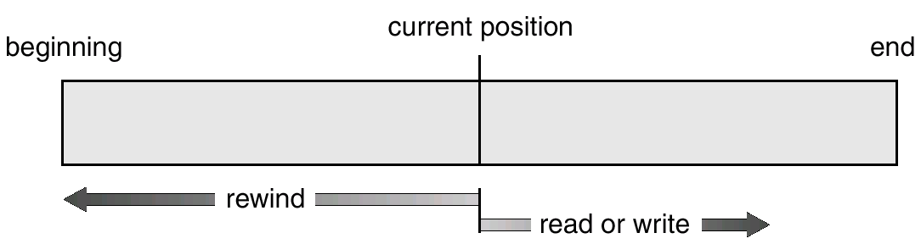
Sequential-access File

Slide 9
Direct Access Method
A file is made up of fixed length logical records
Allow programs to read or write in no particular order
Based on disk model of file
Eg:databases
read n
write n
position to n
read next
write next
rewrite n
n = relative block number

Slide 10
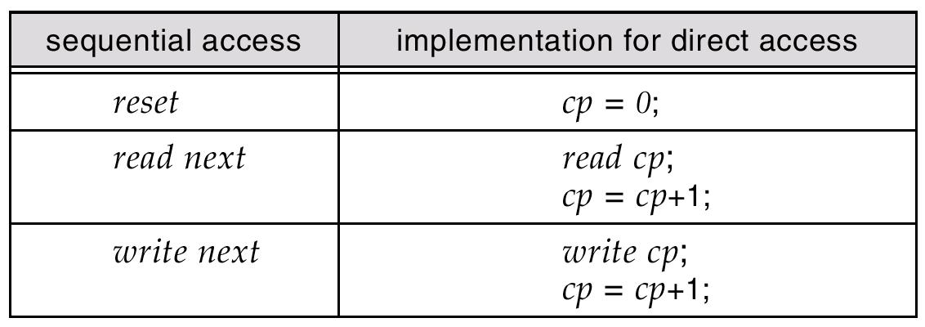
Simulation of Sequential Access on a Direct-access File

Slide 11
Directory Structure
A collection of nodes containing information about all files.
Directory
Files
F 1
F 2
F 3
F 4
F n
Both the directory structure and the files reside on disk.
Backups of these two structures are kept on tapes.

Slide 12
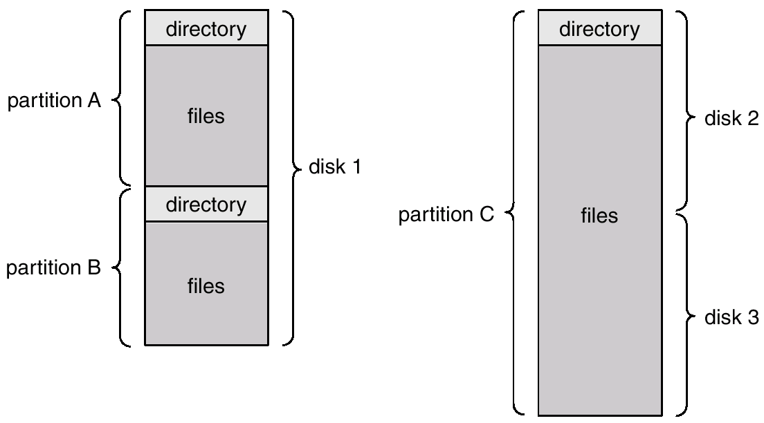
A Typical File-system Organization

Slide 13
Information in a Device Directory
Name
Type
Address
Current length
Maximum length
Date last accessed (for archival)
Date last updated (for dump)
Owner ID (who pays)
Protection information (discuss later)

Slide 14
Operations Performed on Directory
Search for a file
Create a file
Delete a file
List a directory
Rename a file
Traverse the file system

Slide 15
Organize the Directory (Logically) to Obtain
Efficiency – locating a file quickly.
Naming – convenient to users.
Two users can have same name for different files.
The same file can have several different names.
Grouping – logical grouping of files by properties, (e.g., all Pascal programs, all games, …)

Slide 16
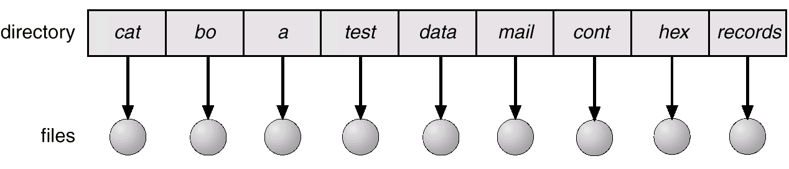
Single-Level Directory
A single directory for all users.
Naming problem
Grouping problem

Slide 17
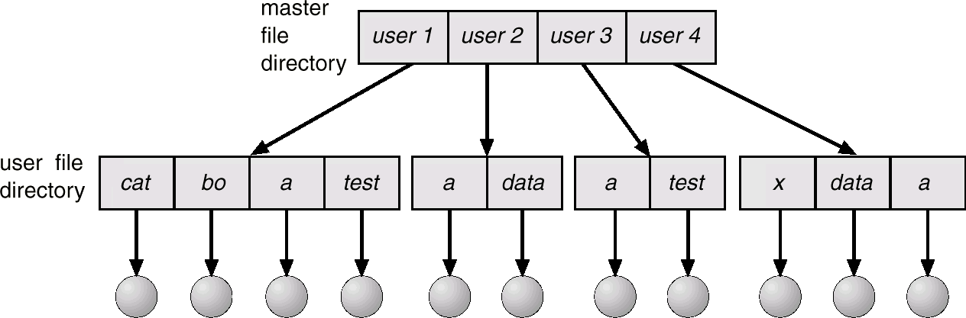
Two-Level Directory
Separate directory for each user.
Path name
Can have the same file name for different user
Efficient searching
No grouping capability

Slide 18
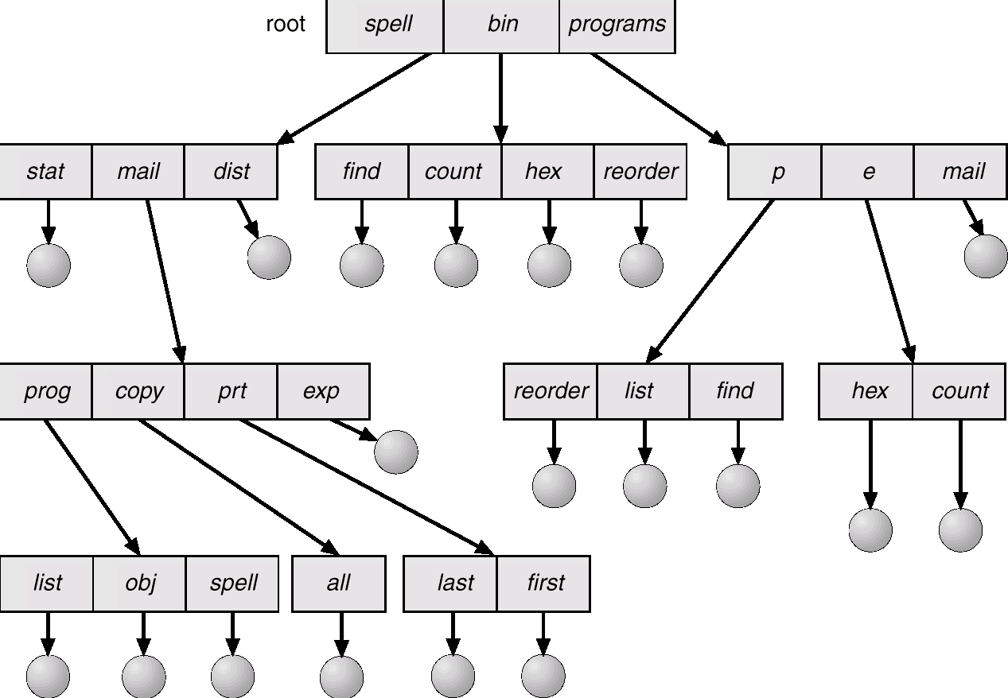
Tree-Structured Directories

Slide 19
Tree-Structured Directories (Cont.)
Efficient searching
Grouping Capability
Current directory (working directory)
cd /spell/mail/prog
type list

Slide 20
Tree-Structured Directories (Cont.)
Absolute or relative path name
Creating a new file is done in current directory.
Delete a file
rm <file-name>
Creating a new subdirectory is done in current directory.
mkdir <dir-name>
Example: if in current directory /spell/mail
mkdir count
mail
prog
copy
prt
exp
count
Deleting “mail” ⇒ deleting the entire subtree rooted by “mail”.

Slide 21
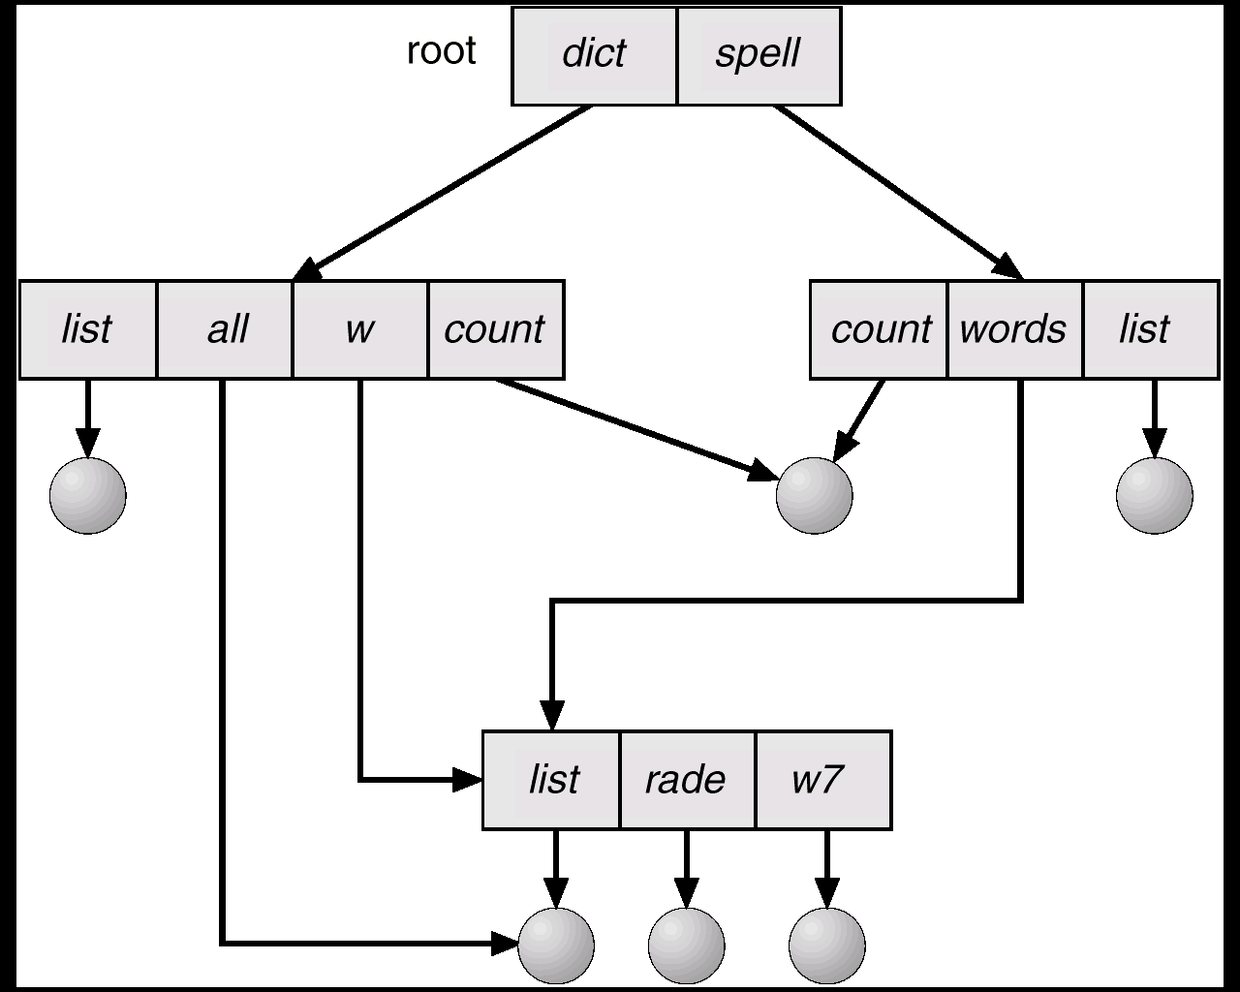
Acyclic-Graph Directories
Have shared subdirectories and files.

Slide 22
Acyclic-Graph Directories (Cont.)
Two different names (aliasing)
If dict deletes list ⇒ dangling pointer.
Solutions:
Backpointers, so we can delete all pointers. Variable size records a problem.
Backpointers using a daisy chain organization.
Entry-hold-count solution.

Slide 23
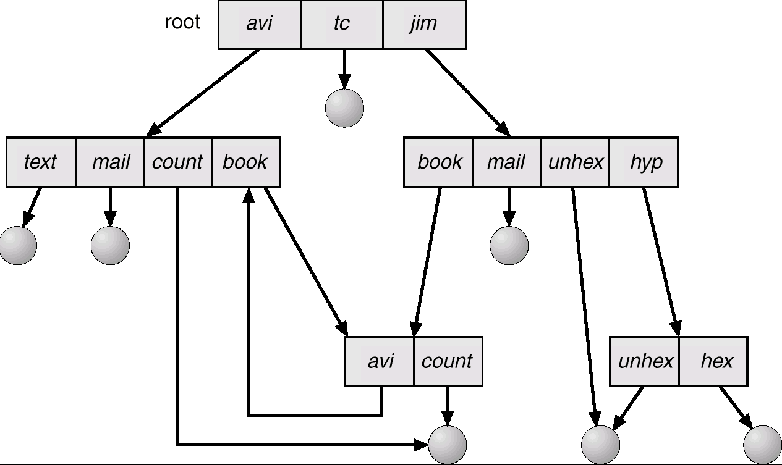
General Graph Directory

Slide 24
General Graph Directory (Cont.)
How do we guarantee no cycles?
Allow only links to file not subdirectories.
Garbage collection.
Every time a new link is added use a cycle detection algorithm to determine whether it is OK.

Slide 25
Protection
When information stored in a computer system it should be safe from physical damage(reliability) and improper access (protection)
Reliability can be provided by copies of files
Protection can be provided by many ways
File owner/creator should be able to control:
what can be done
by whom
Types of access
Read
Write
Execute
Append
Delete
List

Slide 26
Access Control Lists
The most general scheme to implement identity dependent access is to associate with each file and directory an access-control list (ACL) specifying user names and the types of access allowed for each user.
When a user requests access to a particular file, the operating system checks the access list
If that user is listed for the requested access, the access is allowed. Otherwise, a protection violation occurs, and the user job is denied access to the file.
For this scheme to work properly, permissions and access lists must be controlled tightly.

Slide 27
Groups
Mode of access: read, write, execute
Three classes of users
RWX
a) owner access 7 ⇒ 1 1 1 RWX
b) groups access 6 ⇒ 1 1 0
RWX
c) public access 1 ⇒ 0 0 1
Ask manager to create a group (unique name), say G, and add some users to the group.
For a particular file (say game) or subdirectory, define an appropriate access.
owner
group
public
chmod
761
game
Attach a group to a file
chgrp G game

